Slide 1

CAPSTONE PROJECT: Low-Resource Fraud Detection
Presenter: J.P. Mukhwana
Objective: To build an accurate machine learning model for detecting fraudulent transactions using limited data.

Slide 2
Problem Statement & Approach
The Challenge
Our Approach
High rates of digital fraud in low-resource areas with unreliable power and internet.
Utilize a publicly available dataset (MLG-ULB Credit Card Fraud Detection) with limitations.
Limited financial data generation in these regions makes traditional fraud detection models difficult to train.
Focus on maximizing recall while maintaining acceptable precision.
Address class imbalance with SMOTE oversampling.
Compare and optimize Logistic Regression and Random Forest Classifier models.

Slide 3

Data & Preprocessing
Dataset: MLG-ULB Credit Card Fraud Detection (Kaggle)
Anonymized features (V1-V28)
Contains only two days of transaction data
Key Preprocessing Steps:
Removed 1,081 duplicate rows
Severe class imbalance:
Legitimate (Class 0): 284,315
Fraudulent (Class 1): 492
Code Snippet: Data Cleaning
df = df.drop_duplicates().copy()print(f'Dataset now: {df.shape}')

Slide 4
Methodology
01
02
Model Selection
Addressing Imbalance
Logistic Regression & Random Forest Classifier were chosen for their interpretability and efficiency.
SMOTE (Synthetic Minority Over-sampling Technique) was used to balance the dataset.
03
04
Custom Scoring
Model Optimization
A custom metric (precision + 2*recall) / 3 prioritized recall, crucial for fraud detection.
GridSearchCV with StratifiedKFold cross-validation was employed for robust parameter tuning.
Code Snippet: Custom Scorer
def custom_scorer(y_true, y_pred): precision = precision_score(y_true, y_pred) recall = recall_score(y_true, y_pred) return (precision + 2 * recall) / 3

Slide 5
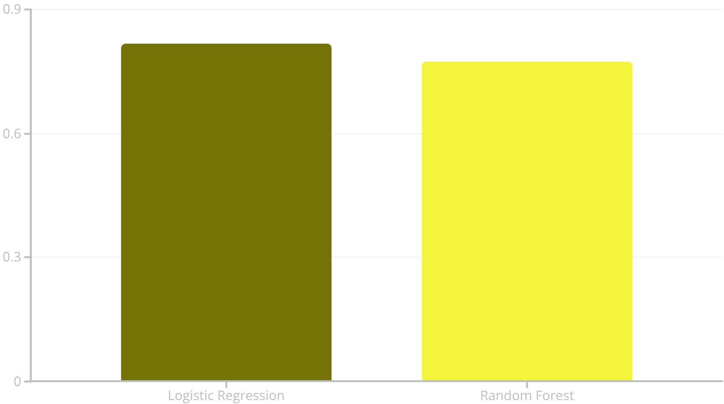
Results
Performance Metrics
Optimized Logistic Regression:
F1-Score: 0.8173
Precision: 0.7303
Recall: 0.9255
Optimized Random Forest Classifier:
F1-Score: 0.7725
Precision: 0.7818
Recall: 0.7634
The Logistic Regression model significantly outperformed the Random Forest Classifier in recall, aligning with our primary objective.

Slide 6


Conclusion & Future Work
Key Findings
Future Work
Optimized Logistic Regression was the most effective solution.
Test on larger, more diverse datasets.
Explore Gradient Boosting and Neural Networks.
Data preprocessing and optimization are crucial for limited datasets.
Implement real-time streaming capabilities for immediate detection.
Custom scoring successfully prioritized recall.
Effective detection is possible even with limited anonymized data.
Our project demonstrates that robust fraud detection is achievable in low-resource settings through careful model selection and tailored optimization.

